Slide 1
Bacterial Growth and Control Problem
Maximizing Hydrolyses and material addition in cell wall

Slide 2
Introduction
Hydrolysis is an important process just as synthesis in the growth and development of a bacterial cell wall.
Peptidoglycan cell wall is a macromolecular network of glycans cross linked by peptides.
The structure is dictated by a outward force due to turgor pressure, that is balanced by the expansion of cell wall network.
Material addition is a process done in spaces created by hydrolysis.
This study aims to obtain an optimal control framing for balancing material addition and hydrolysis in the bacterial cell wall while maximizing growth rate of the cell.
Too much hydrolysis leads to cell wall weakening and lysis
Too little hydrolysis leads to no space for material addition, leading to low growth rate.
To summarize, finding the control functions for hydrolysis and material addition that maximizes cell wall growth while ensuring that cell wall maintains a base level integrity will be the objective of this study.
Goal: Maximizing growth
Ensuring the wall doesn’t weaken
Ensuring there’s enough hydrolysis to allow material addition

Slide 3
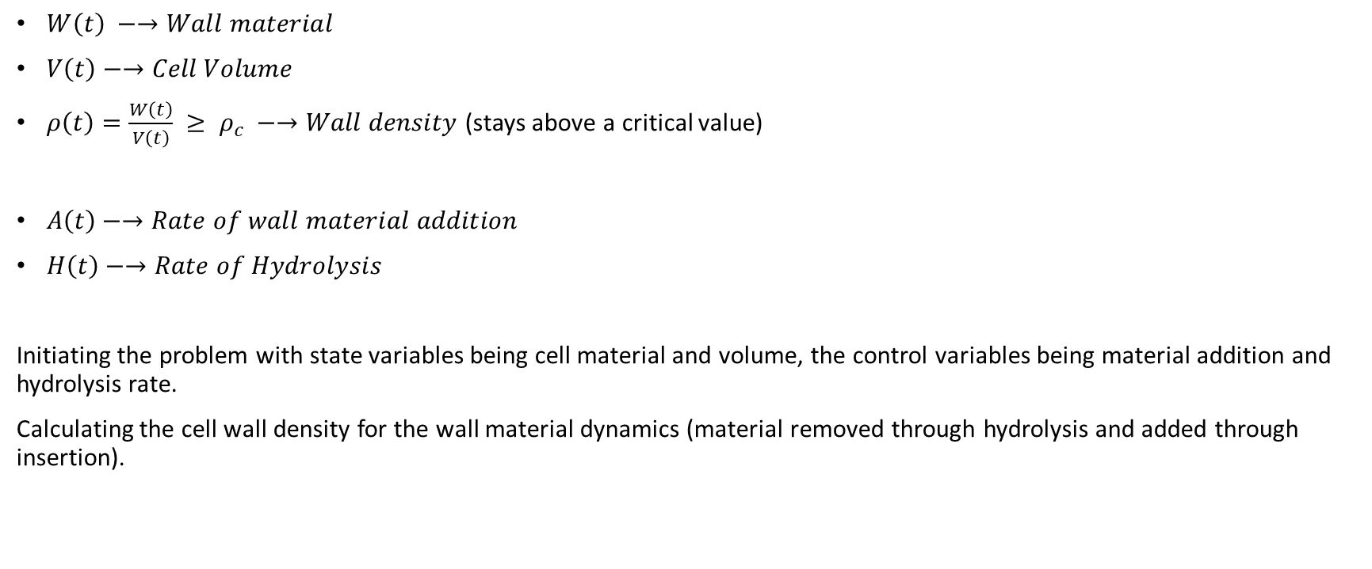
State and Control variables
$W\left(t\right) −→Wall material$
$V\left(t\right)−→Cell Volume$
$ρ\left(t\right)=\frac{W\left(t\right)}{V\left(t\right)} ≥ ρ_{c} −→Wall density$(stays above a critical value)
$A\left(t\right)−→Rate of wall material addition$
$H\left(t\right)−→Rate of Hydrolysis$
Initiating the problem with state variables being cell material and volume, the control variables being material addition and hydrolysis rate.
Calculating the cell wall density for the wall material dynamics (material removed through hydrolysis and added through insertion).

Slide 4

System Dynamics
$\dot{W(t)}= A\left(t\right)- H\left(t\right)−→Net wall material$
$\dot{V}\left(t\right)= γA\left(t\right)H\left(t\right)−→Coarse−grained growth law$
$γ is a scaling factor:Efficiency of volume growth rate$
Volume increases only when both processes are active.
$\text{J}\text{ = }\int_{0}^{t}{V\left(t\right)dt}$ → Maximizing total volume over time (Objective function)
The integral means cumulative growth, not final volume.

Slide 5
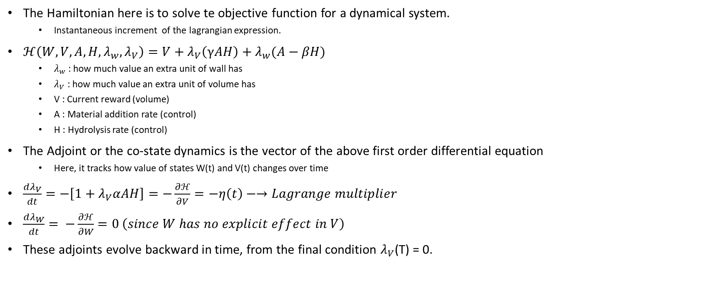
The Hamiltonian
The Hamiltonian here is to solve te objective function for a dynamical system.
Instantaneous increment of the lagrangian expression.
$ℋ\left(W, V, A, H, λ_{w}, λ_{V}\right)=V+λ_{V}\left(γAH\right)+λ_{w}(A−βH)$
$λ_{w}$ : how much value an extra unit of wall has
$λ_{V}$ : how much value an extra unit of volume has
V : Current reward (volume)
A : Material addition rate (control)
H : Hydrolysis rate (control)
The Adjoint or the co-state dynamics is the vector of the above first order differential equation
Here, it tracks how value of states W(t) and V(t) changes over time
$\frac{dλ_{V}}{dt}=−\left[1+λ_{V}αAH\right]=−\frac{∂ℋ}{∂V}=−η\left(t\right)−→Lagrange multiplier$
$\frac{dλ_{W}}{dt}=$ $−\frac{∂ℋ}{∂W}=0 \left(since W has no explicit effect in V\right)$
These adjoints evolve backward in time, from the final condition $λ_{V}$(T) = 0.

Slide 6
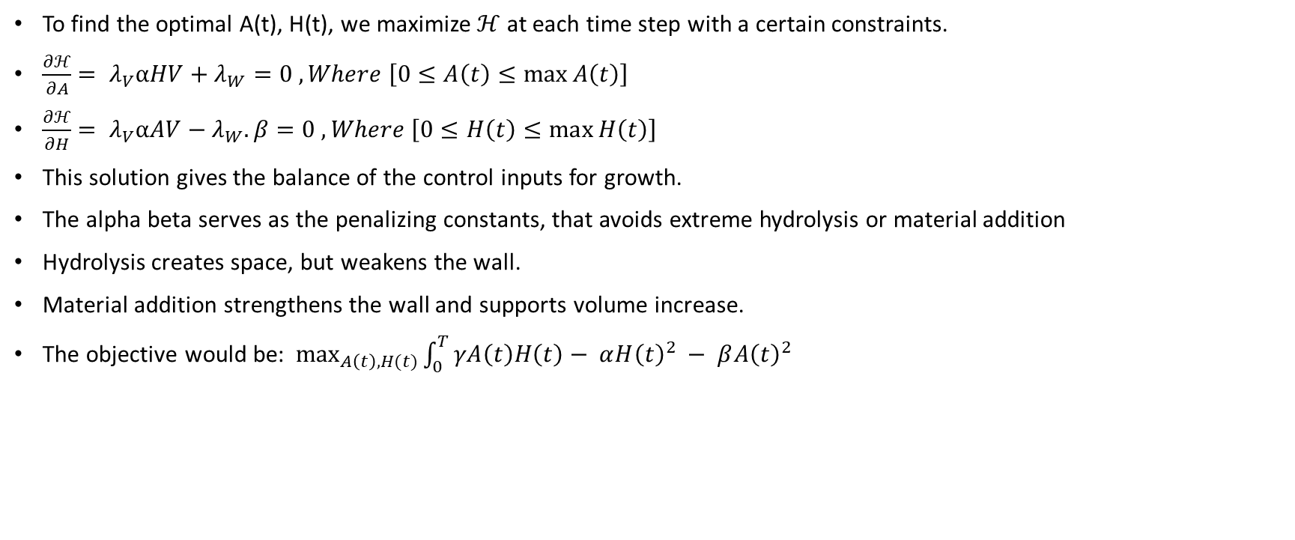
Optimal conditions and constraints
To find the optimal A(t), H(t), we maximize $ℋ$ at each time step with a certain constraints.
$\frac{∂ℋ}{∂A}= λ_{V}αHV+λ_{W}=0 ,Where \left[0≤A\left(t\right)≤\max{A\left(t\right)}\right]$
$\frac{∂ℋ}{∂H}= λ_{V}αAV−λ_{W}. β=0 ,Where \left[0≤H\left(t\right)≤\max{H\left(t\right)}\right]$
This solution gives the balance of the control inputs for growth.
The alpha beta serves as the penalizing constants, that avoids extreme hydrolysis or material addition
Hydrolysis creates space, but weakens the wall.
Material addition strengthens the wall and supports volume increase.
The objective would be: $\max_{A\left(t\right), H(t)}{\int_{0}^{T}{γA\left(t\right)H\left(t\right)− α{H\left(t\right)}^{2} − β{A\left(t\right)}^{2}}}$

Slide 7
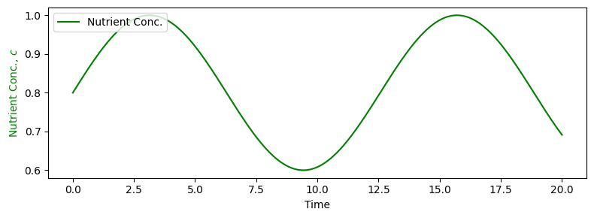
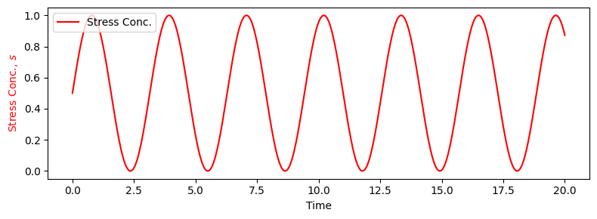

Plots
For chaotic representation, environmental inputs were added:
Nutrient concentration $C\left(t\right)$
Antibiotic stress S$\left(t\right)$
These modulate the control dynamics, playing a role as multipliers.
C(t) enhances A(t): A(t)α C(t)
S(t) suppress either A(t) or H(t) or could directly decrease $γ\left(t\right) :H\left(t\right)α(1−S\left(t\right))$

Slide 8
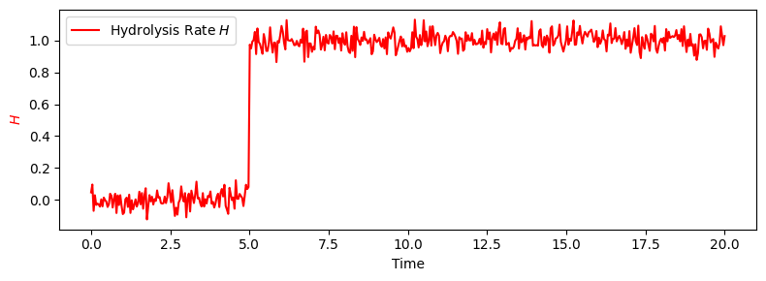
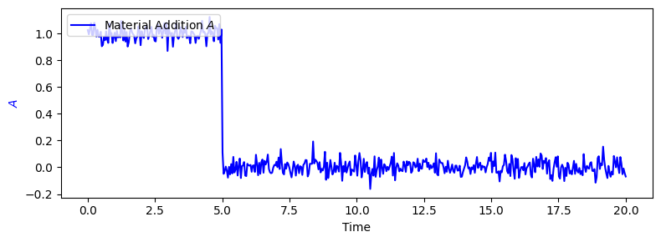

Slide 9
